Slide 1
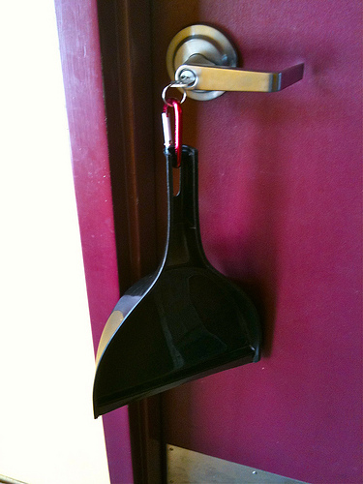



C++ Synchronization
Like C but turbo charged!

Slide 2
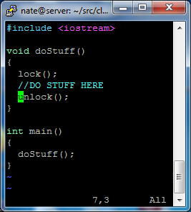
C++ Has constructors/destructors
(big surprise eh)
When is the constructor called?
When is the destructor called?
Specifically let’s talk about stack/local variables
Now back to critical section protection
Super simple right?

Slide 3
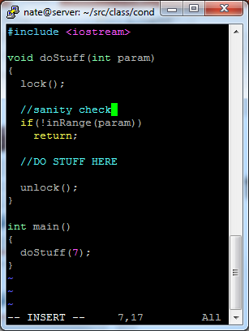
Are there pitfalls with this model?
What if this were a big case/switch?
How about a throw?
Find bug in this code…

Slide 4
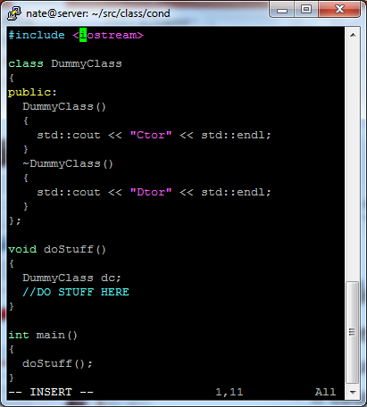
Back to constructors and destructors
What does this code do?

Slide 5
In class exercise
Build a template that:
  Contains an arbitrary object via composition
  Has a constructor that calls lock() on the arbitrary object
  Has a destructor that calls unlock() on the arbitrary object
How can this be used to overcome the issues with the switch/case/return/throw that we observed in the previous code snippets?

Slide 6
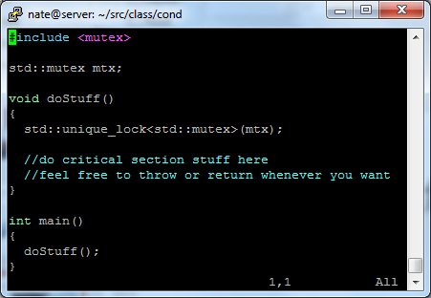
Now that you made one…
C++ already has some
lock_guard is nearly identical to what you wrote
unique_guard has a bit more functionality – movable, deferred locking, recursive, timed locking, etc

Slide 7
There isn’t a C++ specific counting semaphore… There’s something better
A predicate is something that can be evaluated as true or false
  The standard is more complex, but we’ll simplify
  It could be:
    A comparison
    A function that returns a Boolean
    An object that overloads () and returns Boolean
Wouldn’t it be cool if we could signal a thread to wait until some predicate were true?

Slide 8
On to the condition_variable (what we want)
int workItems = 0;
void threadFunc()
{
while(1)
{
while(workItems > 0)
{
//Do the work
workItems--;
}
}
}
We also don’t want this to busy wait when false…

Slide 9
On to the condition_variable (what the implementation looks like)
std::condition_variable cv;
std::mutex mtx;
int workItems = 0;
void threadFunc()
{
while(1)
{
std::unique_lock<std::mutex> lck(mtx);
cv.wait(lck, [](){return workItems > 0;})
{
//Do the work
workItems--;
}
}
}
The condition variable needs a lock, and it does exactly what we want
This decrement is protected by the mutex, and we know there is work to do

Slide 10
And here is how we add work
This increment is protected by mutex
std::condition_variable cv;
std::mutex mtx;
int workItems = 0;
void addWork()
{
std::unique_lock<std::mutex> lck(mtx);
workItems++;
lck.unlock();
cv.notify_all();
}
This is only an optimization; not necessarily needed
Let the sleeping thread know to wake up and check predicate

Slide 11
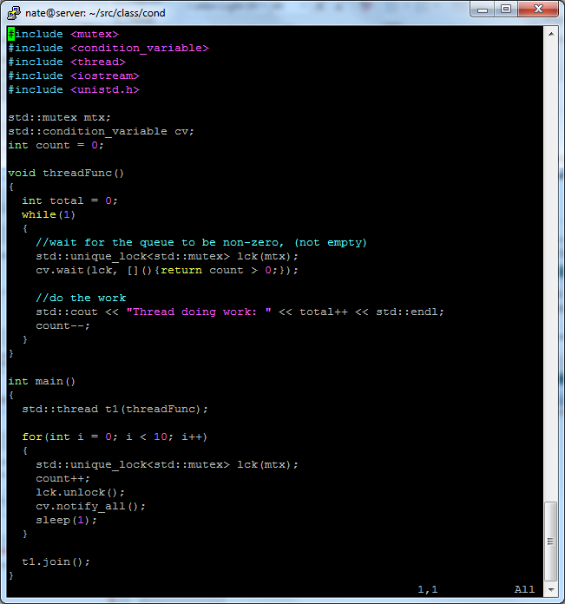
Putting it all together

